Slide 1
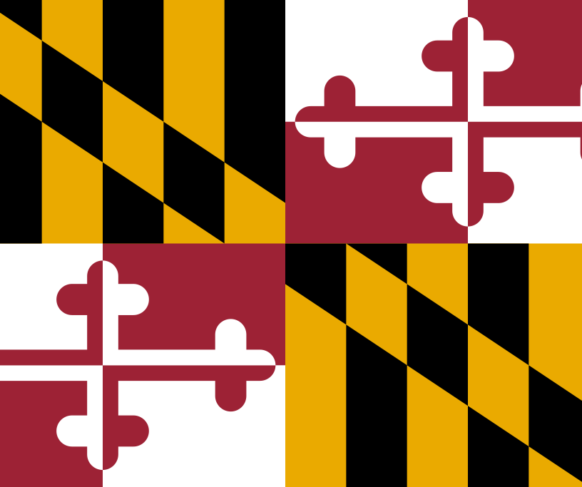
Digital Library Review:
Digital Maryland
INFO 5740 Summer 2020
University of North Texas
Joanna Russell Bliss

Slide 2
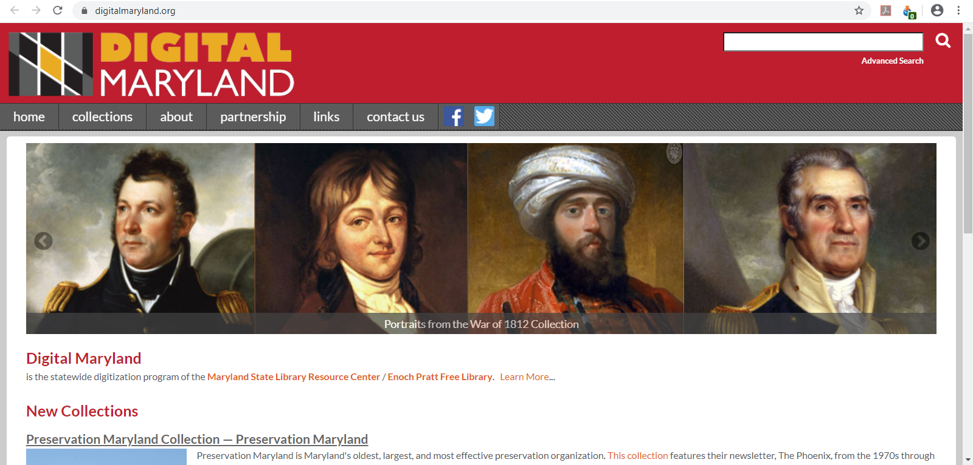
DL Name: Digital Maryland
DL URL: www.digitalmaryland.org

Slide 3
Historical Background and Community
According to Wikipedia (2019), Digital Maryland was launched in 2002 (History), but the date is not currently cited on either the Digital Maryland site or that of the Maryland State Library Resource Center, which is the host organization.
Digital Maryland includes its mission statement on its About page (n.d.):
“Digital Maryland (previously Maryland Digital Cultural Heritage or MDCH), is a collaborative, statewide digitization program of the Maryland State Library Resource Center, Enoch Pratt Free Library. Its mission is to facilitate the digitization and digital exhibition of the historical and cultural documents, images, audio and video held by Maryland institutions,” (para. 1).
While Digital Maryland doesn’t mention a particular audience, its parent organization, the Maryland State Library Resource Center, states that its services and resources are for “for Maryland libraries and their customers,” (About SLRC, 2020, Mission).

Slide 4
Like other state-driven organizations, Digital Maryland is a statewide partnership for digitizing primary artifacts and resources from and about the state of Maryland. Their Partnership page (n.d.) does not give a list of member partners, but their Advanced Search (n.d.) page highlights collections from 70 unique partners (see Appendix A). These partners include:
  The statewide library collection, housed at the Enoch Pratt Free Library in Baltimore, along with other regional and local Maryland libraries
  Maryland historical societies
  Schools, colleges, and universities
  County organizations
  Museums and art clubs
  Private individuals
  Maryland-based companies, like the Bethlehem Steel Company
Historical Background and Community

Slide 5
Historical Background and Community
Funding
As a part of the State Library Resource Center (SLRC), Digital Maryland “is funded through a grant that is part of the Maryland State Budget, and serves public, academic, school, and special libraries in Maryland,” (About SLRC, n.d., What is SLRC?).
The same page also notes that the SLRC falls under both the Maryland State Department of Education Division of Library Development and Services, and an SLRC Commission that is made of librarians from across the state (About SLRC, n.d., SLRC Responsibilities: SLRC Operations).
The SLRC is required to make a variety of short- and long-term plans with and for these organizations. As long as they can demonstrate their value through these plans, and this way of preserving and sharing resources is pragmatic, Digital Maryland should be able to keep its funding.

Slide 6
Historical Background and Community
Partners
Digital Maryland offers a variety of services to its partner organizations, including the creation of master and derivative files, storage on Digital Maryland servers for long-term preservation, the creation of metadata, and consultation for digital projects (Partnership, n.d., Benefits of partnership).
Prospective partners must apply to Digital Maryland for digitization and partnership. Criteria for inclusion as outlined on the Partnership page (n.d.) includes significance of the resources to the state of Maryland and its history, the condition of the resources and the scope of the digitization project, and the state of copyright for the resources (Selection criteria).

Slide 7
Content
While it is clear from the About and Partnerships pages (n.d.) that all of the resources relate to Maryland and its history in some way, the site does not have the most thorough descriptions or search features. As there is no way to filter or search by resource type, for example, it is difficult to determine what file types are available throughout the collections.
Because they use Dublin Core standards to label their resources, however, the Advanced Search can be used to search for DC standard format types.
  Nearly 109,000 are labeled as images, both original photographs and those taken of physical objects.
  More than 9,000 have been labeled as textual, showing that some objects like propaganda posters are labeled as both “image” and “text” in this field (... and WE talk about sacrifice: Buy War Bonds, 1943, Type).
  A much smaller percentage, less than 500 resources, are classified as “moving image.”
See slide 21 for more information on their use of Dublin Core for metadata.

Slide 8
Content
In order to see a total of the resources saved to the site, one must open a single collection and select “All collections.” When the selected collections are updated on the page, one sees the total number of records on the site: 115,915.
As expected from the mission stated on the website, the majority of the resources within the collections relate to the state of Maryland in some way. Types of resources include:
  Photographs of people who contributed to Maryland and its society, as well as old homes, buildings and machines.
  Scans of documents like personal correspondence (including account ledgers for farmers and businesses), maps, promotional posters, and old funeral programs.
  Oral histories, submitted as both print interviews and videos.
  Photographs of historic objects, including military medals, campaign buttons, and inventions.

Slide 9
Content
Featured collections
Digital Maryland features collections in a couple of different ways.
The home page includes a feature on two new collections, although the entry page for both collections doesn’t mention when they were created, so it’s difficult to tell when they were posted.
One of those collections is from Preservation Maryland, which includes almost 1000 pieces.
https://collections.digitalmaryland.org/digital/collection/pmpm
The collection consists of copies of the organization newsletter, as well as “photographs and documents that detail their importance in saving the history and places of Maryland,” (Preservation Maryland Collection - Preservation Maryland, n.d., para. 1). Unfortunately, many of the photographs of buildings don’t give any context to why the selected buildings are important for preservation, or any other history on the locations.

Slide 10
Content
Featured collections
The second new collection is from the Star-Spangled Banner Flag House, one of four collections with this particular partner.
https://collections.digitalmaryland.org/digital/collection/p17340coll27
Unlike the other collections, which seem to focus on a particular theme (two on personal correspondence and another on a flag replica project), this collection is simply named the “Star-Spangled Banner Flag House Collection,” featuring items that are owned by the museum.
The digital resources are photographs of military, political and historical memorabilia: buttons, ribbons and pins that celebrate military victories, promote political candidates George Washington and Theodore Roosevelt and military heroes like Kasimir Pulaski, and honor anniversaries of companies and schools.
The metadata gives thorough physical descriptions of the items, but, like the Preservation Maryland collection, little to no context on the historical importance of the objects.

Slide 11
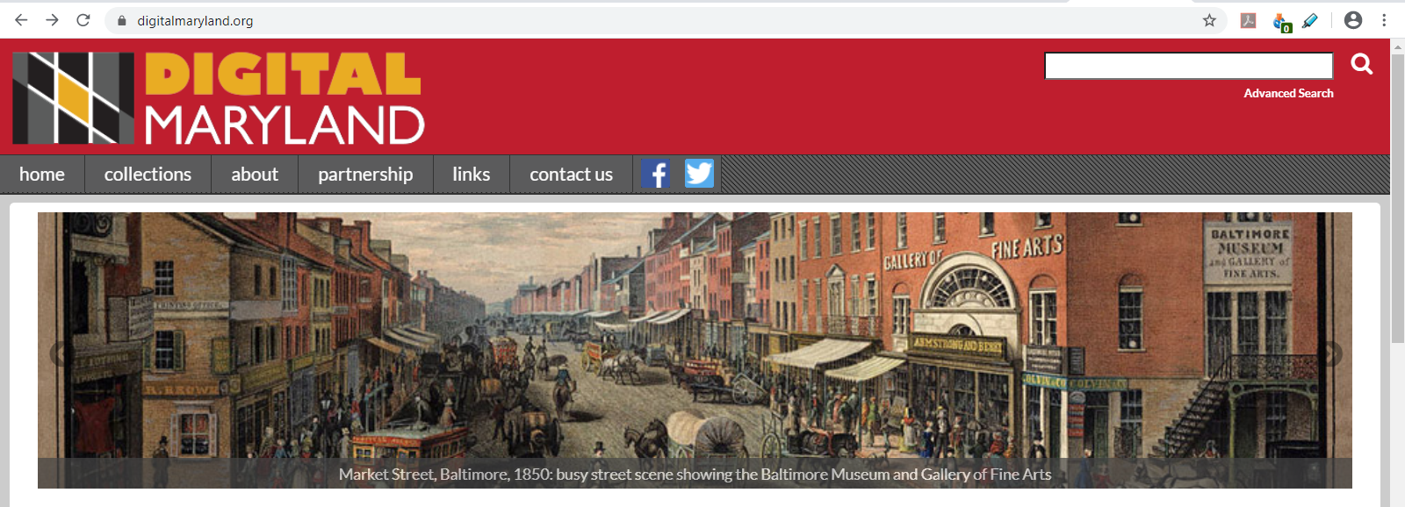
Content
Featured collections
Digital Maryland also has a scroll on its home page that links to featured collections. However, the links and corresponding text are somewhat misleading: The text in the scroll describes specific resources in the collections (which are shown in the image with the text), but the links point to the collection as a whole.
Each of the featured collections in the following slides was linked to from the feature scroll in the home page as of June 18, 2020.

Slide 12
Content
Featured collections
Baltimore Transit Co. and Potomac Edison Slides - Pennsylvania Trolley Museum
https://collections.digitalmaryland.org/digital/collection/btpe
Like the next featured collection, this one gives a slice of life in Baltimore, but of a much smaller time frame: All 408 color images were taken by the same photographer, Ed Miller, in 1952 and 1953 (Baltimore Transit Co. and Potomac Edison Slides - Pennsylvania Trolley Museum, n.d., Contributor).
These images highlight the end of a time when trolleys were all over cities like Baltimore; the introduction to the collection points out that they were all retired by 1963 (Collection Overview, n.d., para. 3). Bright yellow trolley cars stand out from brick buildings and lush trees throughout the city, the photographs a reminder of a vibrant transit system that enabled easy travel throughout the city as compared to the single subway line in Baltimore today (Map Showing Car, Bus and Trackless Trolley Lines of the Baltimore Transit Company, 1945; Metro Subway Link, n.d.).

Slide 13
Content
Featured collections
Cator Collection of Maryland Views - Enoch Pratt Free Library
https://collections.digitalmaryland.org/digital/collection/cator
This collection donated from George Cator to the Enoch Pratt Free Library features paintings and drawings of the city of Baltimore. Digital Maryland doesn’t give much information on Mr. Cator, but research shows that he was a prominent businessman in Baltimore at the turn of the century (Maryland: A Guide to the Old Line State, 1940, p. 222; “George Cator Dead at 76 in Baltimore,” 1932). The guide published in 1940 also notes that the full Cator collection includes “1500 subjects and 200 engravings,” (p.222), of which the digital collection has posted 192.
This collection features engravings, clippings, photographs and paintings that give a window into what Baltimore looked like from the 1750s to the 1920s. While the descriptions of the resources are spare, scanning the collection shows the evolution of the city over almost 200 years.

Slide 14
Content
Featured collections
H. L. Mencken Collection - Enoch Pratt Free Library
https://collections.digitalmaryland.org/digital/collection/mencken
Journalist and author H. L. Mencken lived and worked in Baltimore, Maryland, his entire life. According to the introductory page of the collection (n.d.), he was a frequent visitor to various libraries in Baltimore both as a student and as a journalist. He began donating materials to the library while he was still alive, and he bequeathed the rest of his papers upon his death in 1956, creating 8 collections of writing, correspondence and research now housed at the Enoch Pratt Free Library in Baltimore (H. L. Mencken Room, n.d., The Collection).
The digital collection at Digital Maryland features 173 of the resources from this incredible archive. Each piece includes a detailed description of the context of the resource, as well as physical descriptions.

Slide 15
Content
Featured collections
Sports in Maryland - Enoch Pratt Free Library
https://collections.digitalmaryland.org/digital/collection/mdsm
This collection celebrates the history of sports in Maryland, with a variety of resources related to common sports like baseball and football, as well as more unusual competitions like ice fishing and figure skating. While this particular collection includes 66 resources, the introduction (n.d.) notes that the physical collection housed in Baltimore has thousands of items (Collection overview, para. 4).
Descriptions of the resources in this collection are thorough and allow users to piece together the history of certain sports in the Chesapeake Bay. Unfortunately, the selection of this collection seems a bit uneven. For example, while the introduction to the collection (n.d.) mentions lacrosse and horse racing as important to Marylanders, neither is represented in the resources. This seems odd compared to their treatment of figure skating: There are 21 resources related to figure skating, which is only mentioned offhandedly in the introduction.

Slide 16
Content
Featured collections
Views of African American Life in Maryland - Enoch Pratt Free Library
https://collections.digitalmaryland.org/digital/collection/mdaa
This collection includes almost 250 photographs, and the introduction (n.d.) to the collection notes it is only a fraction of those held by the Enoch Pratt Free Library in Baltimore (Collection overview).
The descriptions in this collection give excellent context to the scenes represented in the photographs as related to the experiences of African Americans in Maryland. One example stood out when browsing the collection. The Description for a photograph from the 1912 Democratic national convention (1912 Democratic Party National Convention at the Fifth Regiment Armory, Baltimore, 1912) outlines the events of the evening and how they related to the support of African Americans for the eventual candidate, Woodrow Wilson. In addition, the Description notes that many catering businesses in Baltimore at that time were owned by African Americans, possibly explaining the racial inequities in the photograph.

Slide 17
Content
Featured collections
War of 1812 - Maryland Historical Society
https://collections.digitalmaryland.org/digital/collection/mhwe
The introduction to this collection (n.d.) gives excellent context to the importance of the War of 1812, both to American history and the history of the Chesapeake Bay.
The collection features 45 resources, including paintings of persons involved in the war, etchings and photographs of relevant locations, and photographs of objects held in the physical collection at the Maryland Historical Society.
A few of the resources have included information that give context to the object or person (Cohen, Mendes I., 1796-1879, n.d., Description; Roberts, George, n.d., Description), but most only include a physical description of the object.

Slide 18
Content
Featured collections
Woman's Land Army of America 1918-1923 - Montgomery County Historical Society
https://collections.digitalmaryland.org/digital/collection/mhfa
The introduction to the collection (n.d.) defines this “land army,” also abbreviated as the WLAA, and explains how they worked the land in Maryland in the first few years after World War I.
The collection includes 39 resources that are photographs of the women working on farms, newspaper clippings about the program, correspondence (both typed and hand-written), and a photograph of a pin given to women associated with the organization.
The descriptions in this collection are thorough, giving context to each resource.

Slide 19
Content
Exhibits
The website also has two exhibits listed at the bottom of its Collections home page, although they are not featured anywhere else, making them difficult to find.
It looks like these are the oldest pages in the collection. The URLs are structured differently, the page layout is older and awkward (for example, it’s clear they are not mobile-friendly, and the content hovers to the left of the screen instead of automatically centering). Suspicions are confirmed when one sees the copyright dates at the bottom of the home pages of each exhibit.

Slide 20
Content
Exhibits
Fire and Faith: The Catonsville Nine File (2005)
http://c9.digitalmaryland.org/
As noted on the Collections page at Digital Maryland (n.d.), this exhibit includes resources from “Cornell University Library, Friends of the Catonsville Branch of the Baltimore County Public Library, Herman Heyn, Dean Pappas, Lynne Sachs and University of Baltimore Library,” (Exhibits: Fire and Faith: The Catonsville Nine File).
The exhibit has a home page with background information on the event, as well as tabs leading to information on what exactly happened at the event, the trial, other helpful contextual information, profiles of the people involved, and a page to search the exhibit that includes a site map of all of its pages.

Slide 21
Content
Exhibits
Great Baltimore Fire of 1904 (2003, 2004)
https://www.digitalmaryland.org/fire/#
According to the About page within the exhibit (2003, 2004), it includes digital content from “the Enoch Pratt Free Library, Fire Museum of Maryland, Maryland Historical Society, Library of Congress and the Baltimore County Public Library,” (para. 1).
This exhibit really shows its age, which is a shame, because it’s an important event in Baltimore’s history, and it could be an interesting exhibit if it were more interactive. Aside from the About page, there are only two pages in the exhibit, both consisting of maps that show either what was happening throughout the city during the fire, or to see the same areas in the city “today” (i.e., in 2003).
Each of the map pages is complex, particularly the one explaining the progression of the fire. But it would be a much stronger exhibit if the hosts took advantage of more modern tools, like GIS and other
plug-ins, to make the maps even more interactive and to bring the design up-to-date.

Slide 22
Content
The collections are primarily in English, with little mention of any other language. The only resource found referring to a language other than English was a scanned copy of a paper about Lithuanian independence ("We Started Our Resistance Fight for Graining Independence and Freedom Again": A History of Lithuanian Independence, 2015), which had a couple of lines transcribed in Lithuanian, along with a translation in English.
Very few items across the website have been categorized by Language, even the textual items. While more than 9,000 resources have been marked as textual, only 356 items were tagged as Type/Text and Language/English. It’s clear that the field hasn’t been used consistently across the collection as many other textual items have no Language field data at all.

Slide 23
Content
In the collections reviewed, each resource was a digital copy of physical objects, including still photographs, physical memorabilia, scans of correspondence, and more. There is a small distribution of videos (less than 500) across a few oral history collections, but there is no mention of whether these were born digital or have been digitized from analog recordings.
One of the weaknesses of these collections is that they often do not include context for the inclusion of or importance of these resources. While each collection links back to the home page of its partner’s website, the resources are not linked to any further descriptions or exhibits at the partner institutions. If the institution does not add a detailed Description within the metadata when the resources are added to the collection at Digital Maryland, users must go elsewhere to understand why this particular resource has meaning within the collection.

Slide 24
Content
Metadata
Title (2 options)
Subject
Description (3 options)
Creator
Publisher
Contributors
Date (6 options)
Type
Format (3 options)
Identifier
Source
Language
Relation (14 options)
Coverage (3 options)
Rights
Audience (2 options)
The table on the right lists the searchable metadata fields in the Advanced Search (n.d.) on the site. Where a field is listing as having multiple options, the search feature has that number of entries. For example, the pull-down menu lists both “Title” and “Title-Alternative.”
While there are 16 Dublin Core fields represented in the search, not all fields are represented in the resources. And the site has added a couple of additional fields outside of DC standards, like Holding Institution and OCLC number, as well.

Slide 25
Services
Digital Maryland is an open access collection. No membership or fees are required to access any of the resources.
The site includes a basic, keyword search, as well as an advanced search. There are three features of the advanced search: Being able to select in which collections one would search (users can select one, multiple, or all collections by the name of the collection), a pull-down menu to enable searching the Dublin Core metadata fields previously mentioned, and a date field that can be searched as on, after, before or between any given dates.
The site missed an opportunity to make searches in the Dublin Core fields easier as several of them use controlled vocabularies. While some fields are not controlled, like Description, or there would be too many variables to list, like for Creator, adding a pull-down menu for types of formats would make it easier to search, for example, for videos, particularly when they are labeled “moving image” in the field, which is a term not all users would expect or search by. It would also be helpful to search by Holding Institution, which is not given as an option in the Advanced Search.

Slide 26
Services
Search results are sorted by relevance, with the ability to change the sorting order by description, title or subject. Subject, creator and date labels appear to the left of the search results, but users cannot filter by them; users only have the option to select one at a time if it is of interest.
In theory, the site includes help functions, as the site advertises a Help feature on the About page (n.d., Last point under Search tips), but the Help feature does not appear where described on the Collections page or in Search results. The only navigation tips offered are on the site’s About page (n.d., Search tips), and the site does not include an FAQ page.

Slide 27
Services
The only way to interact with Digital Maryland through the website is on its Contact Us page (n.d.), where they list an (unhyperlinked) email address for inquiries. They have links on the Contact Us page to accounts on Twitter and Facebook, but neither account has posted in 2020.
Other than that, Digital Maryland does not seem to offer any services to or interactions with users – no bibliographies for further information, nor instructional guides for using the collections. There is no discussion forum for users or any other user interaction service like an RSS, wiki or blog. And there is no way to customize the site for any user.
In summary, this site is a perfect example of Pomerantz’s (2008) comment about services at digital libraries: “DLs have traditionally been environments in which new technologies for organizing, searching, and accessing digital objects have been experimented with. Services to users, on the other hand, have traditionally not been as strong in DLs,” (p. 10).

Slide 28
Technology
It appears that Digital Maryland has its own server vs. an outside one, as the site notes that partnership with Digital Maryland includes “Storage of archival master images for long-term preservation” and “Technical infrastructure and support for hosting digital objects,” (Partnership, n.d., Benefits of partnership).
Digital Maryland uses ContentDM to manage their collections, as noted on the Partnership page (n.d.) when explaining their metadata creation standards (Standards).
The site architecture is well-organized, making it easy to navigate, browse, and find information. Advanced search forms are clearly made by librarians (using the Dublin Core fields for most of the search) but not necessarily difficult for searchers to use. Few visualizations are used, except in the one exhibit mentioned, and more would help users see commonalities between collections and resources.
Digital Maryland does not seem to have any special provisions for security or quality of service; there are no disclaimers about cookies or privacy when using the site.

Slide 29
Related Literature
Where I searched: “Library & Information Science Source” and “Library Science” databases, as well as within the archives of the following journals:
  D-Lib
  IEEE/ACM Joint Conference on Digital Libraries (JCDL)
  International Forum on Research and Technology Advances in Digital Libraries (ADL)
  International Journal on Digital Libraries
  World Digital Libraries
What I found: One brief review that was accessible via the Library & Information Science Source database; a second was not accessible.
I agreed with Sommer’s (2018) basic assessment of the site. He notes that the site is easy to navigate and has a number of impressive resources, and he concludes that “The Digital Maryland site is an excellent resource for researchers who want to understand the rich history of the state of Maryland,” (pp. 151-152).

Slide 30
Personal Analysis
Room for improvement:
Navigation
The fact that they advertise a Help feature on the About page (n.d., Last point under Search tips) that doesn’t appear where they describe on the Collections page or in Search results is quite frustrating. Several links take me to dead pages. Navigation tools like arrows that should take me to the next or previous page reload the page instead. And many links open in new tabs, which can also be irritating as one browses through the website.
Given that the site has more than 100 collections, creating a way to browse by a category or general subject from the Collections page would be helpful. For example, the site appears to have a number of resources related to the Civil War spread throughout collections, but if I search for “civil war,” I have to scroll through various unrelated resources on the Persian Gulf War or historians of the Civil War to find truly interesting resources like letters and diaries written by those who lived through the war.

Slide 31
Personal Analysis
Room for improvement:
Content
Sometimes it seems like they err on the side of gaining too much content. The Governor’s Press Office submitted more than 75 photographs from the 10th Adoption Celebration Awards held in 2006, which seems a little excessive. And while I appreciate the American Century Project submitted by St. Andrew’s Episcopal School in Potomac, MD, some of the scanned papers have little to do with Maryland, focusing on Lithuanian independence, apartheid in South Africa, and Libyan terrorism. They are all excellent topics that high school juniors should research and learn more about, but I question their inclusion in a collection housed at Digital Maryland.
The document that kept coming into my head as I saw such disparate resources was the Collection Development Policy (2001) from the Digital Library of Georgia: “Proposed materials or collections must … be related to the culture and history of Georgia,” (Mission). Because Digital Maryland’s Mission is more broad, relating to everything “held by Maryland institutions,” (About, n.d., para. 1), some collections feel out of place, like the ones mentioned above.

Slide 32
Personal Analysis
Room for improvement:
Context & connections across collections
I realize that most libraries do not promote the context of their materials; they leave that to the researchers that are bringing various materials together. But given that many of the partner organizations are museums, where I would expect to see context given throughout an exhibit, I wanted to see more of that when viewing the resources on this site.
This felt particularly wanting when I looked at the two exhibits. Knowing the types of technologies that are available to create engaging visualizations to create connections across collections, I wanted to see more of those connections made, whether by creating categories to browse in the collections area, or by creating visualizations like they tried to do for the exhibit on the fire in Baltimore.
Unfortunately, like with many libraries, I suspect that time and cost are the culprit here. Trying to create such connections and exhibits takes a great deal of time, particularly when you do so with multiple partner organizations. The fact that the most recent exhibit was created in 2005 is also a sign that the current managers of the site just don’t have the time or resources to create any more of them.

Slide 33
Personal Analysis
Positives
Overall, this is an impressive collection of resources related to the history of Maryland. As a former resident (albeit only for 2.5 years) and an amateur historian, I can appreciate the range of timelines reflected in the resources, particularly those that reach back to pre-Revolutionary days when Maryland was an English colony.
When thinking as a resident looking for more information on the state, it was easy to find resources using keyword searches. Only looking for specific formats and file types was a bit challenging.
The interface is user-friendly, with easy-to-use frames displaying the resources, which also include the option to expand to nearly full screen. Textual artifacts include transcripts that are very helpful, as well as the ability to flip through multiple pages one at a time.
This collection is a resource that I would recommend to fellow Marylanders and amateur historians, as well as researchers looking for primary resources from and about the state of Maryland.

Slide 34
References
About SLRC. (2020). State Library Resource Center [of Maryland]. https://www.slrc.info/about/
Collection Development Policy. (2001, July). Digital Library of Georgia. http://dlg.galileo.usg.edu/colldev.html
Digital Maryland. (n.d.). https://www.digitalmaryland.org
Digital Maryland. (2019, October 26). In Wikipedia. https://en.wikipedia.org/w/index.php?title=Digital_Maryland&oldid=923179774
“George Cator Dead at 76 in Baltimore.” (1932, February 26). New York Times. https://www.nytimes.com/1932/02/26/archives/george-cator-dead-at-76-in-baltimore-was-long-a-leading-figure-in.html
H. L. Mencken Room. (n.d.). Enoch Pratt Free Library. https://www.prattlibrary.org/locations/mencken/index.aspx?id=4918

Slide 35
References
Map Showing Car, Bus and Trackless Trolley Lines of the Baltimore Transit Company. (1945). In “Lost City: Baltimore’s Trolleys, Trackless Trolleys and Buses.” (2017). Underbelly: From the Deepest Corners of the Maryland Historical Society Library. https://www.mdhs.org/underbelly/2017/03/30/lost-city-baltimores-trolleys-trackless-trolleys-and-buses/
Maryland: A Guide to the Old Line State. (1940). New York: Oxford University Press. https://books.google.com/books?id=K6BlU1wPV7oC&dq
Metro Subway Link. (n.d.). Maryland Department of Transportation. https://www.mta.maryland.gov/schedule/metrosubway
Pomerantz, J. (2008). Digital (library services) and (digital library) service. Journal of Digital Information, 9(2).
Sommer, T. (2018). Digital Maryland. College & Research Libraries News, 79(3), 151–152.

Slide 36
References
Wheeler, M. (2010). Flag of Maryland [ClipArt image]. Open Clip Art. https://openclipart.org/detail/90175/usa-maryland

Slide 37
Appendix A
List of partners
I broke down the list of collections to identify the partners who contributed to them and to remove duplicates. This is the list of unique partners from that analysis.
Allegany College of Maryland
Allegany County Historical Society
Ann Arrundell County
B & O Railroad Museum
Baltimore and Ohio Railroad
Baltimore County Public Library
Baltimore Museum of Art
Baltimore Streetcar Museum
Bethlehem Steel Co. Maryland
Captain Avery Museum
College Park Aviation Museum
Community Media Center
Eastern Shore Regional Library
Emory Grove Association
Enoch Pratt Free Library
Fair of the Iron Horse
Federalsburg Historical Society
Frances Benjamin Johnston
Franklin Academy
Frederick County Public Libraries
Genealogy and Family History
George's Creek Regional Library
Gilman School
Goucher College
Governor Press Office
Greensboro Historical Society
Hampton National Historic Site
Harford Community College
Harford County Public Library
Historical Society of Baltimore County
Historical Society of Carroll County
Howard County Historical Society
HSBC
Jerry Kelly
Joe Schuller and Donald Kobi
John Franklin Goucher Papers
London Town and Gardens Collection
Maryland Historical Society
Montgomery College
Montgomery County Historical Society
Nabb Research Center, Salisbury Univ.
National Electronic Museum
National Federation of the Blind
Pennsylvania Trolley Museum
Preservation Maryland
Preserving the Legacy of Maryland and the Civil War
Presidential Documents
Prince George's County Historical Soc.
Queen Anne's County Free Library
Ralph Buglass
Reginald F. Lewis Museum
Richard Rowe
Ruth Enlow Library
Salisbury University
Somerset County Library
Southern Maryland Regional Library Assoc.
St. Andrew's Episcopal School
St. Mary's College of Maryland
Star-Spangled Banner Flag House
Surratt House Museum
Talbot County Free Library
Thurmont Historical Society
United States Naval Academy
University of Baltimore
University of Maryland Baltimore County
Ward Museum of Wildfowl Art
Washington County Free Library
Washington County MFA
Winkler Private Collection
Worcester County Library, Berlin Br.

